Slide 1
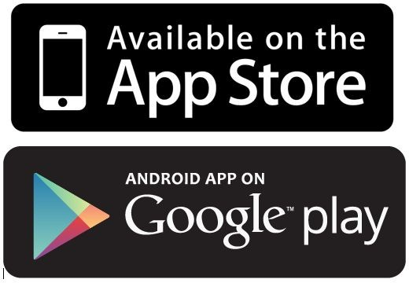
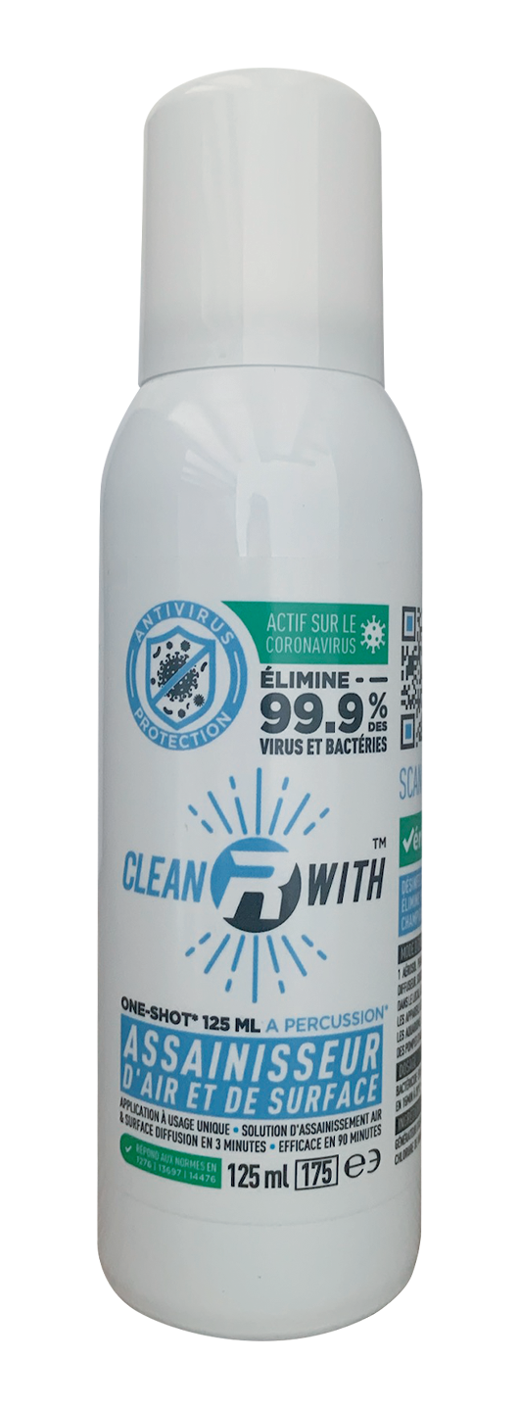
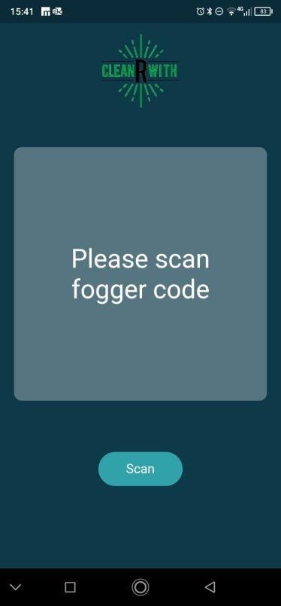

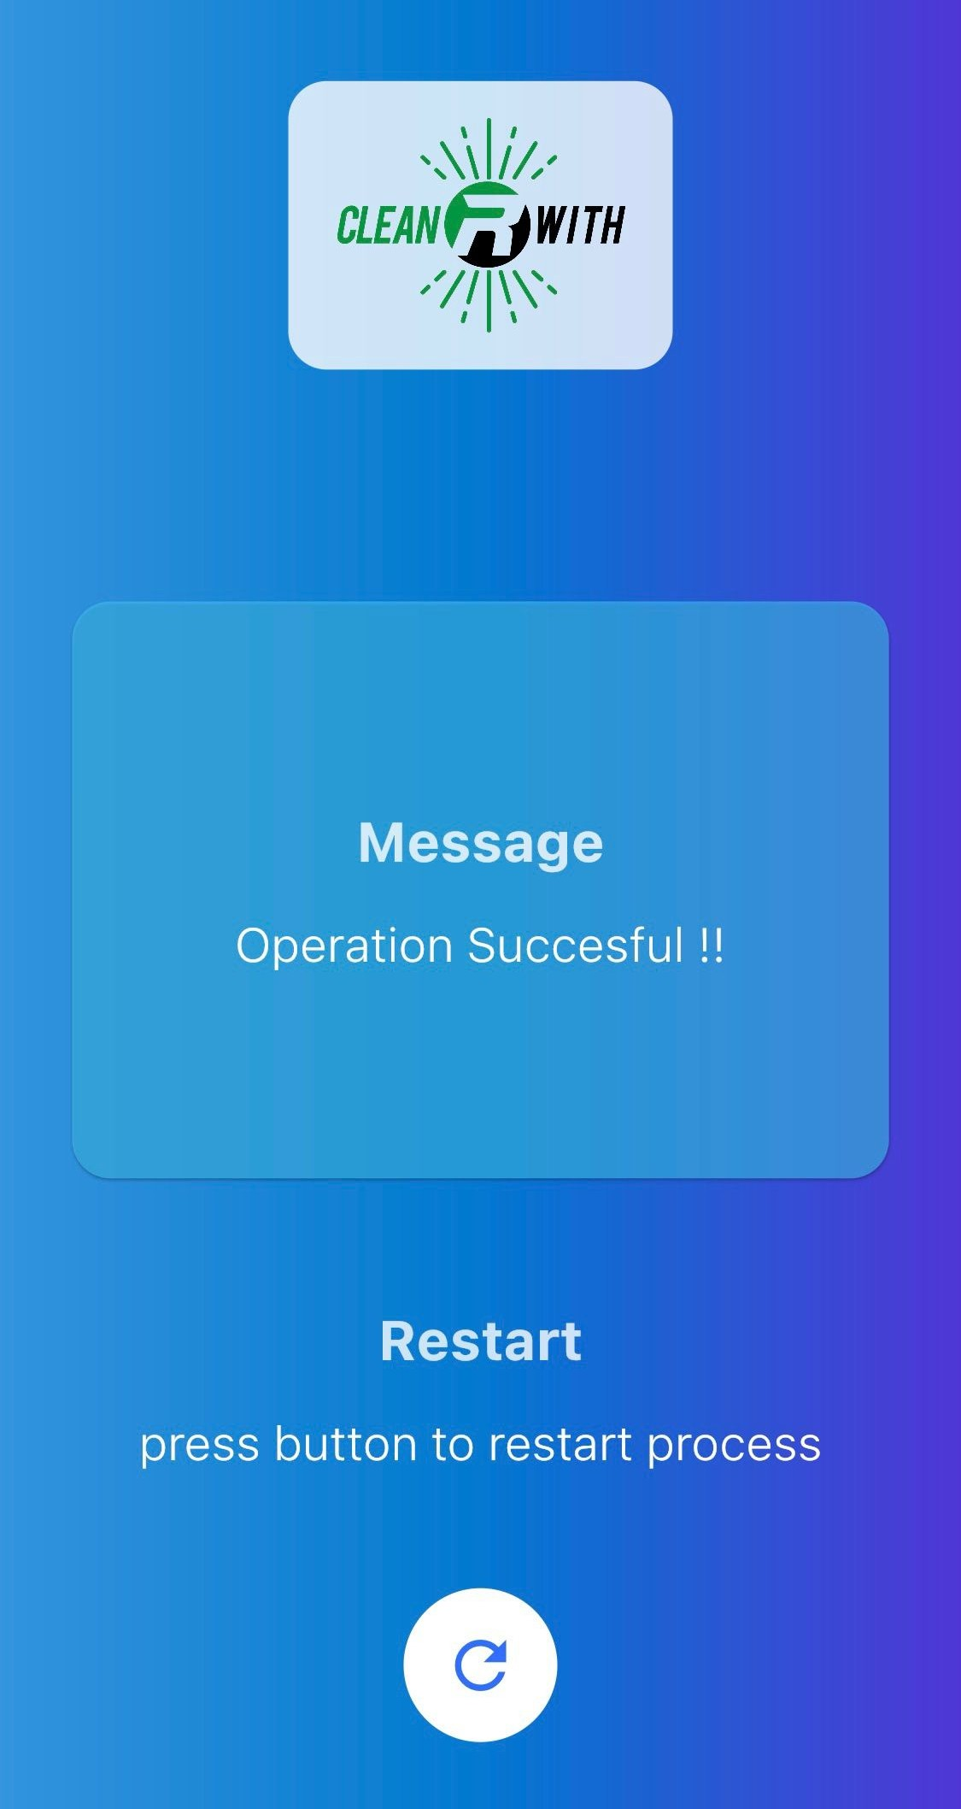
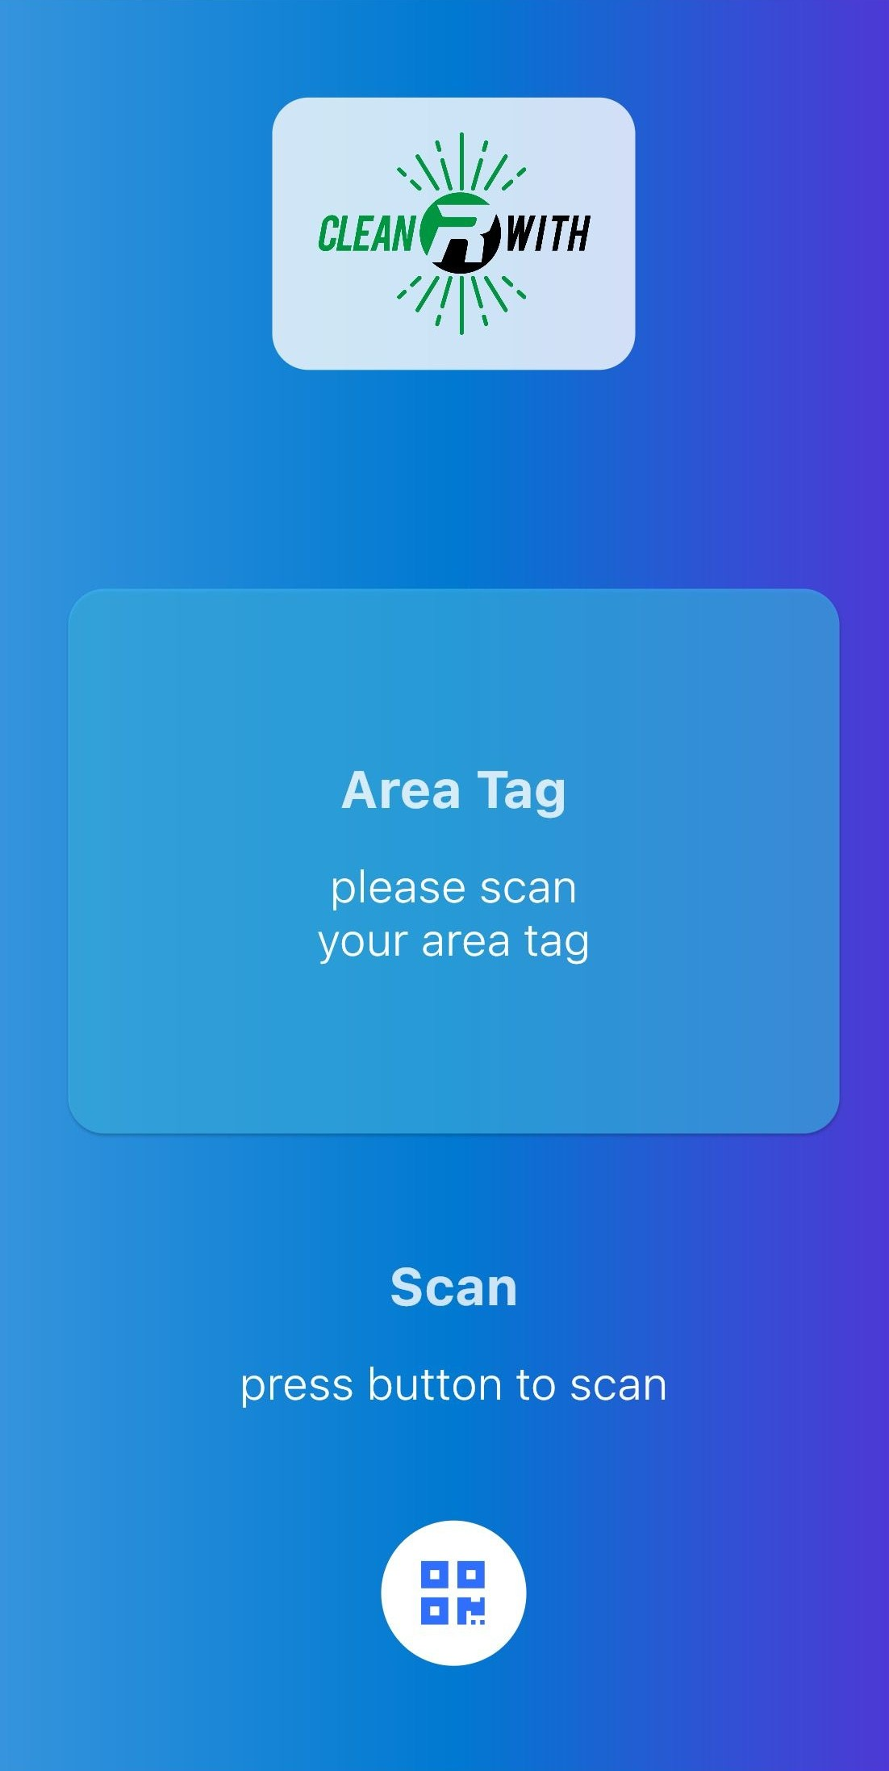
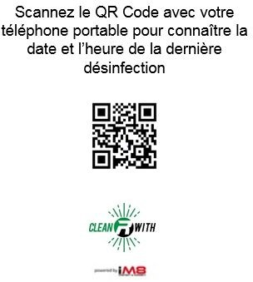



How traceability works
1
Download the free CleanRwith app
to establish and register your time-stamped certificate.
2
Scan the QR Code placed in the area to be disinfected
3
Scan the QR Code on the bottle
4 Traceability is activated, the can and location are locked together!
2
3
4
Scan
Scan

Slide 2


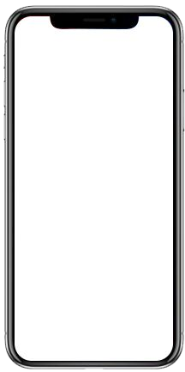
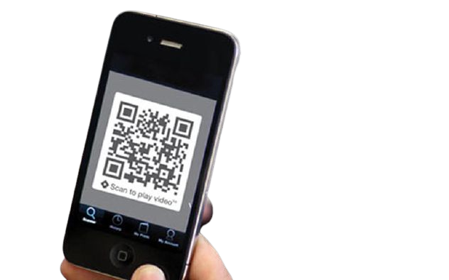
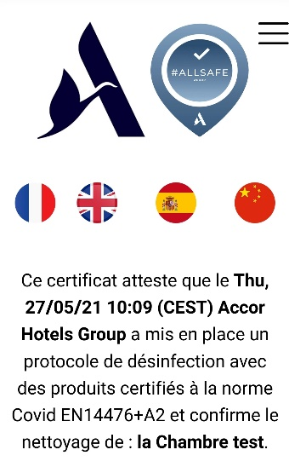
Reassure customers and staff through our secure blockchain
Check the date and time of the last disinfection
by scanning the Code QR in the room
Scan

